Slide 1
Web Development and API Design Lesson 02: Bash, Regex, Build Tools and Testing
Prof. Andrea Arcuri

Slide 2
Goals
Review/intro to Bash Terminal
Review/intro to Regular Expressions
Build tools: YARN, WebPack and Babel
How to write test cases

Slide 3
Bash

Slide 4
Bash
Bash is a Linux/Mac/Unix shell and command language
There are also other kinds of shells
eg, PowerShell in Windows
A shell is also called: terminal, console, command-line, etc.
Enable to type commands (eg programs), and execute them

Slide 5
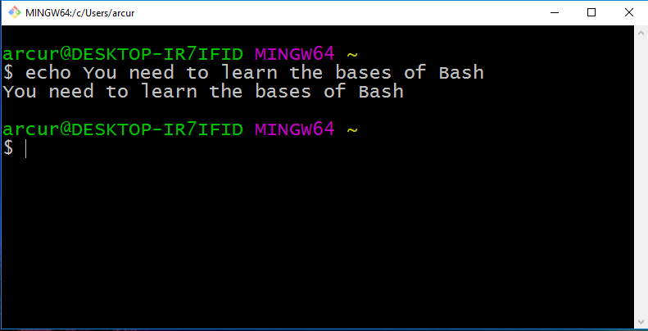

Slide 6
Why?
Critical skill when you are a programmer
Help automating several tasks
When dealing with web/enterprise systems, many servers will NOT have a GUI…
… you will access them remotely via SSH using a terminal
… this also applies for embedded and IoT devices
Helpful when commands with specific parameters (eg Git)
You need to be able to do basic commands
You will need Bash commands if using Docker

Slide 7
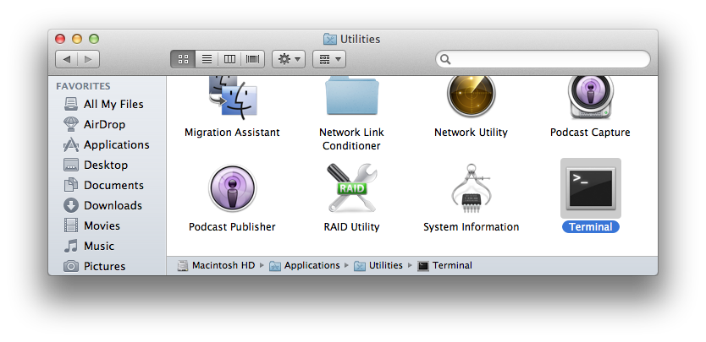
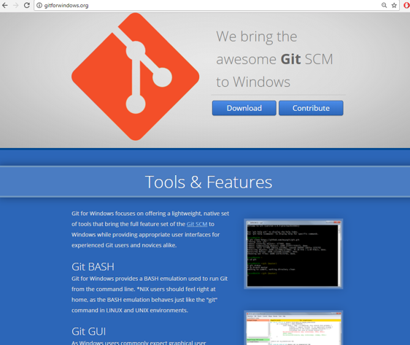
Installing Bash
If you are using Linux/Mac, it is already installed
Mac: Utilities -> Terminal
If using Windows, strongly recommended to install GitBash
which is part of “Git for Windows” at http://gitforwindows.org/

Slide 8
Basic Commands
“.” the current directory
“..” the parent directory
“~” home directory
“pwd” print working directory
“cd” change directory
“mkdir” make directory
“ls” list directory content
“cp” copy file
“mv” move file
“rm” remove (“-r” for recursive on directories)
“man” manual for a specific command

Slide 9
Cont.
“echo” print input text
“cat” print content of file
“less” scrollable print of file
“>” redirect to
“>>” append to
“|” pipe commands
“which” location of program
“$” resolve variables
“wc” word count
“find” files
“grep” extract based on regular expression
“touch” modify access time of file, and create it if non-existent

Slide 10
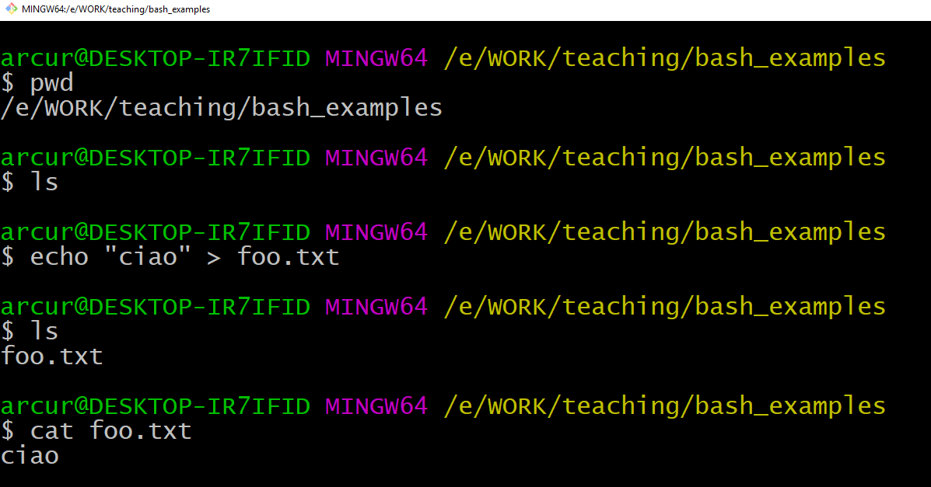

Slide 11
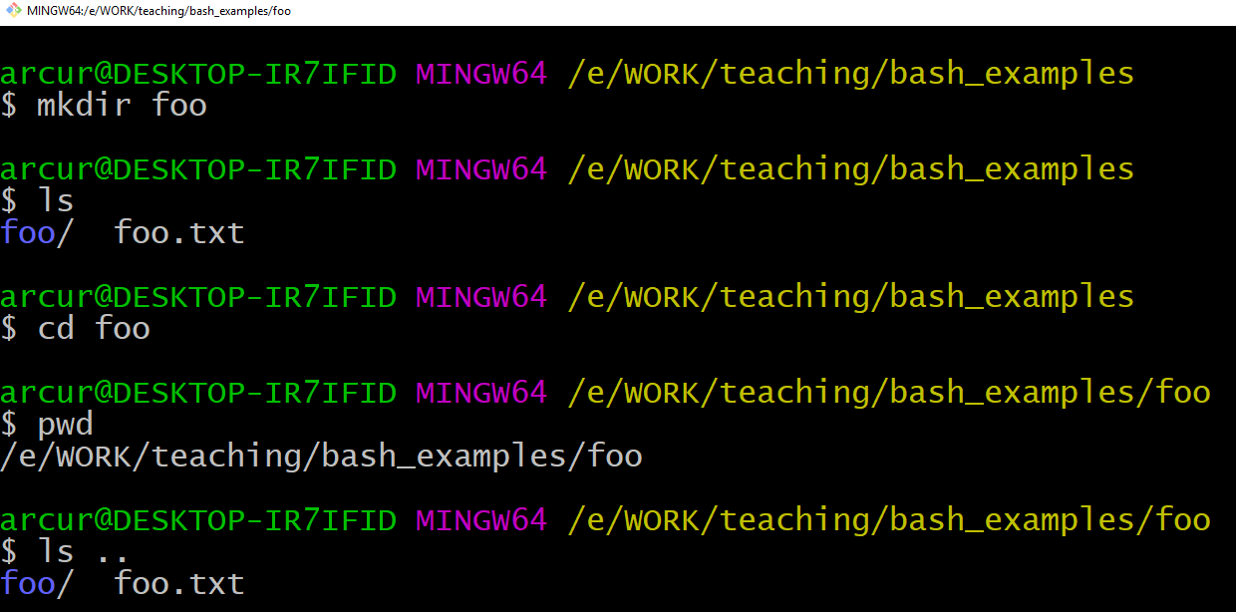

Slide 12
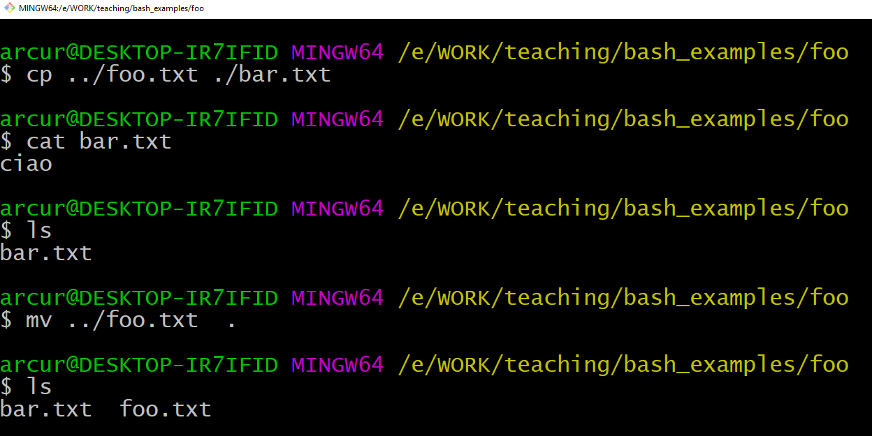

Slide 13
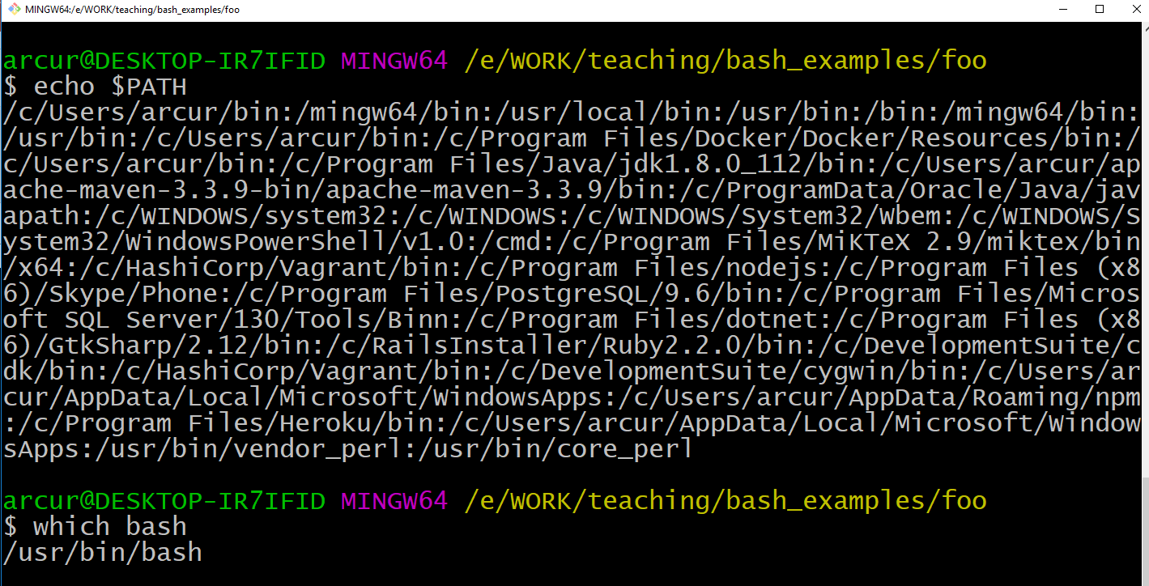

Slide 14
What if you want to count the number of JavaScript files in your project?
Or count the total number of lines in all those files?

Slide 15
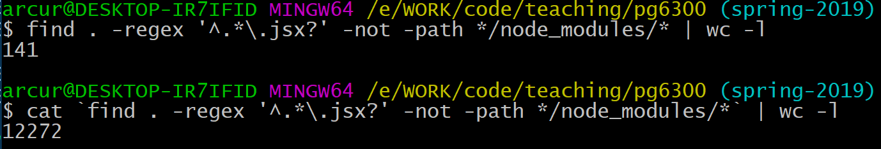
“find” all the files recursively in the current folder “.”
matching the regular expression for JS/JSX files
“^” beginning of file name
“.*” any character (.), any number of times (*)
“\.” escaped any-character to represent the character “.”
“\.jsx?” file ending, where the last “x” is optional (ie “?”)
“-not -path */node_modules/*” excludes files of imported dependenices
“| wc -l”: pipe file names to line count program
cat `x`: the `` executes the command inside it, and then puts the output on the terminal
so, we print all content of all JS/JSX files with cat

Slide 16
Useful Tips
User arrows (up/down) to go through history of commands
Use “tab” key to complete words, ie commands / file names
Bash commands can be put in executable scripts
Can use “*.sh” as file extension, eg “foo.sh”
First lines needs to be “#!<pathToBash>”, eg “#!/usr/bin/bash”
Then it can be executed from terminal like any other program

Slide 17
Regular Expressions

Slide 18
Constraints
Is “loreipsum.com” a valid email address?
no, it does not have the symbol “@”
Is “3fenfrje35ddsre123345” a valid telephone number?
no, it contains non-digits, and it is likely too long
When a String represents a specify type of value (eg, emails), we can use a regex to specify its constraints
eg, the subset of all possible strings representing a valid email
eg, common when validating inputs in HTML forms

Slide 19
Definition, Regex is either:
An empty set
An empty string
A single character
A regex enclosed in parentheses ()
Two or more concatenated regexs
Two or more regexs separated by or operator |
A regex followed by the the closure operator *

Slide 20
Matching Characters
Wildcard “.” matches any character
eg, “a.b” match any 3-letter word starting with “a” and ending with “b”
Set [] matches any single character in the set
eg, [abc] does match “a”, “b” and “c”, but not “d”, nor “ab”
Range [-] matches in the range
eg, [a-z] matches any lower case letter, [a-zA-Z] any letter, [0-8] any digit but 9
Meta-characters need to be escaped with “\”
eg, “\[\.\]” would match “[.]”, but not “a” nor “[a]”

Slide 21
(), | and *
() use to define boundary of a regex
| is an or between two expressions
* applies the previous regex 0 or more times
Eg, “ab*” does match “a”, “ab” and “abbbbbbbb”
Eg, “(ab)*” does match “”, “ab”, “abab” and “abababab”
Eg, “(ab)|c” does match “ab” and “c”

Slide 22
Shortcuts
“+” at least once
“x+” equivalent to “xx*”
“?” zero or one time
“x?” equivalent to “emptyString | x”
“{}” specific number of times
“x{5}” equivalent to “xxxxx”
“x{2,4}” equivalent to “(xx)|(xxx)|(xxxx)”

Slide 23
Example: Telephone Number
8 digit number
eg, 40012345
Might be preceded by a country code, which is either a + or 00 followed by 2 digits
eg: +47 or 0047

Slide 24
Regex for Telephone Number
((\+|00)[0-9]{2})?[0-9]{8}

Slide 25
First time you see a regex…

Slide 26
((\+|00)[0-9]{2})?[0-9]{8}
Either a + or a 00. Note that + must be escaped with \
Previous block inside () is optional: can be there, or not
Any digit between 0 and 9, repeated exactly 2 times

Slide 27
((\+|00)[0-9]{2})?[0-9]{8}
Any digit between 0 and 9
Previous block repeated exactly 8 times

Slide 28
Limitations of Regex
Regex are very useful in many contexts to check the validity of strings that are supposed to have constraints
However, they are not fully expressive, as there are constraints you cannot express with a regex
Example: you cannot use a regex to check if a string is a valid JavaScript code
for that, you need a Context-Free Grammar, but we will not see them in this course

Slide 29
Do Not Use Regex for HTML!!!
https://stackoverflow.com/questions/1732348/regex-match-open-tags-except-xhtml-self-contained-tags
… Rege̿̔̉x-based HTML parsers are the cancer that is killing StackOverflow it is too late it is too late we cannot be saved the trangession of a chi͡ld ensures regex will consume all living tissue (except for HTML which it cannot, as previously prophesied) dear lord help us how can anyone survive this scourge using regex to parse HTML has doomed humanity to an eternity of dread torture and security holes using regex as a tool to process HTML establishes a breach between this world and the dread realm of c͒ͪo͛ͫrrupt entities (like SGML entities, but more corrupt) a mere glimpse of the world of reg​ex parsers for HTML will ins​tantly transport a programmer's consciousness into a world of ceaseless screaming, he comes, the pestilent slithy regex-infection wil​l devour your HT​ML parser, application and existence for all time like Visual Basic only worse he comes he comes do not fi​ght he com̡e̶s, ̕h̵i​s un̨ho͞ly radiańcé destro҉ying all enli̍̈́̂̈́ghtenment, HTML tags lea͠ki̧n͘g fr̶ǫm ̡yo​͟ur eye͢s̸ ̛l̕ik͏e liq​uid pain, the song of re̸gular exp​ression parsing will exti​nguish the voices of mor​tal man from the sp​here I can see it can you see ̲͚̖͔̙î̩́t̲͎̩̱͔́̋̀ it is beautiful t​he final snuffing of the lie​s of Man ALL IS LOŚ͖̩͇̗̪̏̈́T ALL I​S LOST the pon̷y he comes he c̶̮omes he comes the ich​or permeates all MY FACE MY FACE ᵒh god no NO NOO̼O​O NΘ stop the an​*̶͑̾̾​̅ͫ͏̙̤g͇̫͛͆̾ͫ̑͆l͖͉̗̩̳̟̍ͫͥͨe̠̅s ͎a̧͈͖r̽̾̈́͒͑e n​ot rè̑ͧ̌aͨl̘̝̙̃ͤ͂̾̆ ZA̡͊͠͝LGΌ ISͮ̂҉̯͈͕̹̘̱ TO͇̹̺ͅƝ̴ȳ̳ TH̘Ë͖́̉ ͠P̯͍̭O̚​N̐Y̡ H̸̡̪̯ͨ͊̽̅̾̎Ȩ̬̩̾͛ͪ̈́̀́͘ ̶̧̨̱̹̭̯ͧ̾ͬC̷̙̲̝͖ͭ̏ͥͮ͟Oͮ͏̮̪̝͍M̲̖͊̒ͪͩͬ̚̚͜Ȇ̴̟̟͙̞ͩ͌͝S̨̥̫͎̭ͯ̿̔̀ͅ

Slide 30
Build Tools

Slide 31
YARN/NPM
We need to use external libraries, typically open-source
An important library we are going to use in the rest of the course is for example React
Two main tools in JS: YARN and NPM
Both YARN and NPM access the same dependency repository
YARN tends to be better, with new features coming earlier
We will use it from terminal
As YARN executes JS code, we need a runtime for it: that is the reason why you also need to install NodeJS
not going to start a build tool inside a browser…

Slide 32
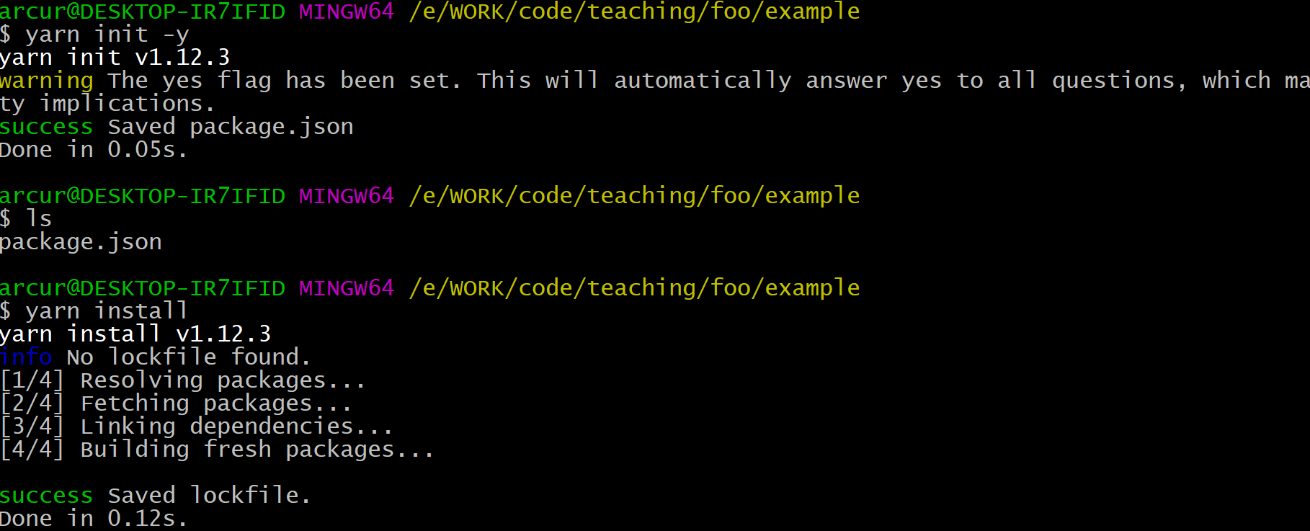
yarn init –y
create a new package.json in current folder, needed when starting new project
yarn install
download and install in “node_modules” folder all the dependencies declared in package.json

Slide 33
package.json
Main configuration file for the project
Similar to pom.xml in Maven Java projects
Three main parts you need to care about:
scripts: executable commands from YARN. Eg, to build or run the app
dependencies: dependencies used in the project
devDependencies: dependencies only used during development, but not being part of the final app (eg, we will see WebPack)

Slide 34
JSON for Configuration Files
<rant>
JSON as format for configuration files is simply awful.
For example, you cannot have comments…
NPM is not better, as uses exactly the same package.json
</rant>

Slide 35
yarn.lock
Once you install the dependencies, you will see that YARN does create a yarn.lock file
Dependencies need to define which version to use, eg 1.0.2
You can use caret ^ to represent the most recent major version
e.g., ^1.0.2 will match ^1.4.1, but not 2.0.0
yarn.lock just tells YARN to use the exact same versions of the libraries when such file was created
extremely important when working in a team, and new minor updates break backward compatibility or introduce new regression bugs
even if you fix a version X of a dependency, this could use other third-dependencies with ^, and so yarn.lock becomes essential

Slide 36
WebPack
Downloading dependencies is not enough
Such dependencies need to be accessed by the HTML pages
Might be cumbersome to update HTML files for each dependency, for each different version
Furthermore, we might only need a small set of functions from a specific library
Solution: bundling with WebPack

Slide 37
Bundling
In the end, we get a single JS file
Your JS files:
foo.js
bar.js
whatever.js
etc.
WebPack
bundle.js
Your libraries:
lodash
react
react-router
etc

Slide 38
Configuring WebPack
Needs to be installed and called with YARN from package.json
webpack-dev-server is a useful tool that starts a HTTP server with hot-reloading
ie, if you modify your JS files, it automatically re-bundle them
"scripts": { "dev": "webpack-dev-server --open --mode development", "build": "webpack --mode production" },
"devDependencies": { "webpack": "^4.16.5", "webpack-cli": "^3.1.0", "webpack-dev-server": "^3.1.5" }

Slide 39
webpack.config.js
Besides being called from package.json, WP also needs its own configurations
Eg, name of the file to create, and which directory to save it into
Configuration done in a JavaScript file

Slide 40
Code Transformation
Bundling is not enough, might need to do transformations
Support other languages: TypeScript and JSX
which are not natively supported by browsers, which only deal with JS
JSX will be essential when dealing with React
Support old browsers:
eg, transform code using new JS features (eg, async/await) into equivalent, valid old JS
Minification:
eg, remove comments and empty spaces from JS files to decrease their size, needed to make their download faster
etc.

Slide 41
Babel
Babel is the main tool to make JS transformations
Need to be installed and configured from package.json
"babel": { "presets": [ "@babel/env" ] }, "devDependencies": { "@babel/cli": "7.7.4", "@babel/core": "7.7.4", "@babel/preset-env": "7.7.4", "babel-jest": "24.9.0",

Slide 42
Testing

Slide 43
Testing
To check the correctness of a program, writing test cases is very important
For dynamically typed language, is even more important
as you lose a lot of warnings and checks from a compiler
Different libraries in JS for testing, but we will use Jest
which is one of the most popular

Slide 44
Configuring Jest
Need entry in scripts to start it
Need extra configurations to find out where the tests are
"scripts": { "test": "jest --coverage" },
"jest": { "testRegex": "tests/.*-test\\.(js|jsx)$", "collectCoverageFrom": [ "src/**.(js|jsx)" ] }

Slide 45
Need Babel for Jest
JS code running in browser
But where are the tests run? We need a JS runtime: NodeJS
But frontend code might not be directly executed on NodeJS
eg, different ways to handle JS modules
Using Babel to make the required transformations to be able to run such code on NodeJS

